Slide 1
Data Analysis in Criminal Justice
Hypothesis Testing with Two Population Means or Proportions

Slide 2
Hypothesis Testing with Two Sample Means
Logic of two-sample inference
Sampling distribution of mean differences
Independent-samples hypothesis testing

Slide 3

Logic of Two-Sample Inference
Research Question
Are these two samples drawn from a single population with mean $μ$, or are they subsets of two different populations with means $μ_{1}$ and $μ_{2}$, respectively?
Under the null hypothesis, the samples are drawn from the same population
$H_{0}: μ_{1}= μ_{2}$

Slide 4

Two Possible Answers
Yes, the samples are drawn from the same population
The observed difference between ${\overline{x}}_{1}$ and ${\overline{x}}_{2}$ reflects a random difference
No, the samples are drawn from different populations
The observed difference between ${\overline{x}}_{1}$ and ${\overline{x}}_{2}$ reflects a systematic difference

Slide 5
Sampling Distribution of Mean Differences
Probability theory
How likely it is that we would observe the difference between the two sample means if the population means are actually equal?
Is the difference random or systematic?
New probability distribution
Sampling distribution of mean differences (not a sampling distribution of means)

Slide 6

Thought Experiment
Random samples of size $n_{1}$ and $n_{2}$, compute mean difference ${\overline{x}}_{1} − {\overline{x}}_{2}$
Compute mean differences for an infinite number of independent samples…
What will happen?

Slide 7
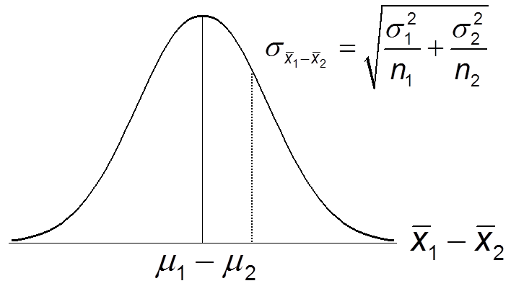

Sampling Distribution of Mean Differences
Distribution of all possible mean differences between two independent samples
Defined by two parameters
Mean = $μ_{1} − μ_{2}$
Std. Dev = $σ_{{\overline{x}}_{1} − \overline{x}₂ }$

Slide 8
Central Limit Theorem
With large n’s, the sampling distribution of mean differences is approximately normal, even if the characteristic is not normally distributed in the populations from which the samples are drawn
We can do hypothesis testing since we know that the probability distribution is normal

Slide 9
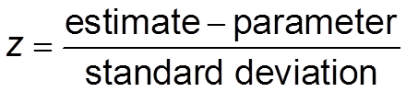
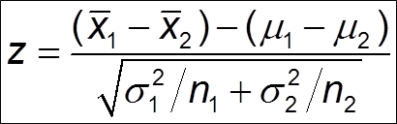
Standard Score for Mean Difference
General form for a standard score
Standard score for mean difference with independent samples

Slide 10
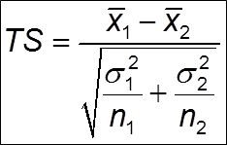
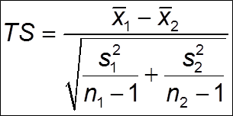

Hypothesis Testing
Test statistic when $σ_{1}$ and $σ_{2}$ are known
Test statistic when $σ_{1}$ and $σ_{2}$ are unknown

Slide 11

Social Disorganization & Violent Victimization
Low-SES neighborhoods
n = 41, $\overline{x}$ = 12.4, $σ^{2}$ = 18.49
High-SES neighborhoods
n = 21, $\overline{x}$ = 5.2, $σ^{2}$ = 2.25
Research question
Do people that live in low-SES neighborhoods have a different risk of victimization than people that live in high-SES neighborhoods?

Slide 12
Social Disorganization & Violent Victimization (cont.)
Step 1: Formally state hypotheses
Step 2: Obtain a probability distribution
Step 3: Make decision rules

Slide 13
Social Disorganization & Violent Victimization (cont.)
Step 4: Calculate the test statistic
Step 5: Make a decision about the null hypothesis

Slide 14

Youth Employment & Problem Behavior
Workers
n = 2243, $\overline{x}$ = 3.73, $s^{2}$ = 12.95
Non-workers
n = 6679, $\overline{x}$ = 2.22, $s^{2}$ = 8.19
Research Question
Do working youths engage in more problem behavior than non-working youths?

Slide 15
Youth Employment & Problem Behavior (cont.)

Slide 16
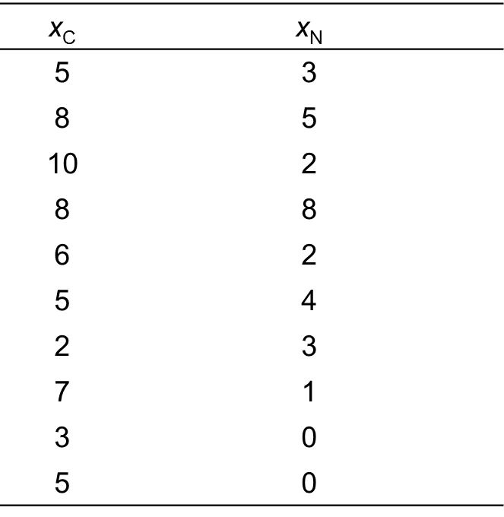
Criminal Lifestyle & Victimization
Victimization among self-report criminals and non-criminals
Research Question
Does a “criminal lifestyle” increase the likelihood of victimization?

Slide 17
Criminal Lifestyle & Victimization (cont.)

Slide 18
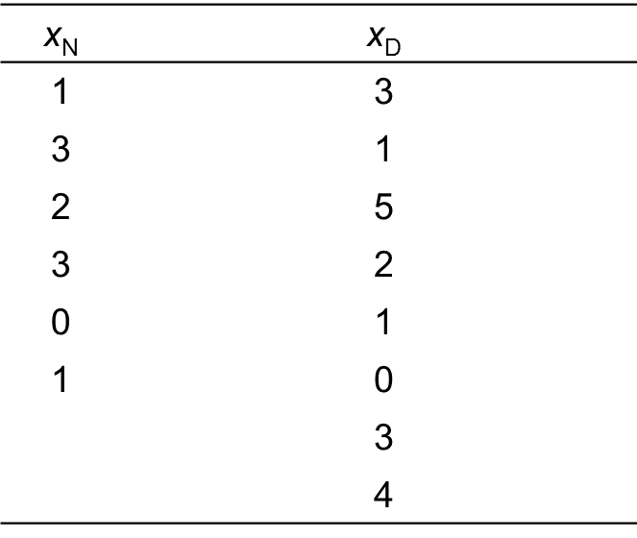
Dating & Delinquency
Delinquency among
self-report daters
& non-daters
Research question
Is there an association
between dating and
delinquency?

Slide 19
Dating & Delinquency (cont.)

Slide 20
Inference with Two Sample Means
Non-independent-samples hypothesis testing

Slide 21
Non-independent Samples
Assumption of independent-samples H test
The two samples must be independent of each other (i.e., both samples are randomly selected) and the fact that one case is selected into one sample does not affect the selection of a different case into the other sample

Slide 22
Non-Independent Samples (cont.)
There are times when the independence condition is deliberately violated
“Before-and-after” design: dependent variable measured for each case at two points in time, with introduction of some treatment in between
“Matched samples” design: individuals in treatment and control conditions matched on important characteristics
e.g., age, gender, & race

Slide 23
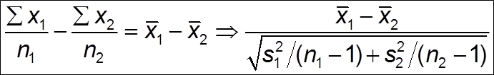
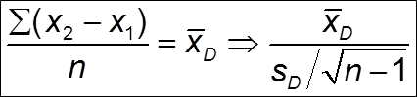
Test Statistics
TS for independent samples
Based on difference between two sample means
TS for non-independent samples
Based on difference between the scores for each pair of observations

Slide 24

Does Crime Run in Families?
Youths with criminal parents matched with youths with non-criminal parents
n = 121, ${\overline{x}}_{D}$ = $\frac{\sum{(x_{C} − x_{N})}}{n}$ = 5.75, $s_{D}$ = 4.25
Step 1: Formally state hypotheses
Step 2: Obtain a probability distribution
Step 3: Make decision rules

Slide 25
Does Crime Run in Families? (cont.)
Step 4: Calculate the test statistic
Step 5: Make a decision about the null hypothesis

Slide 26
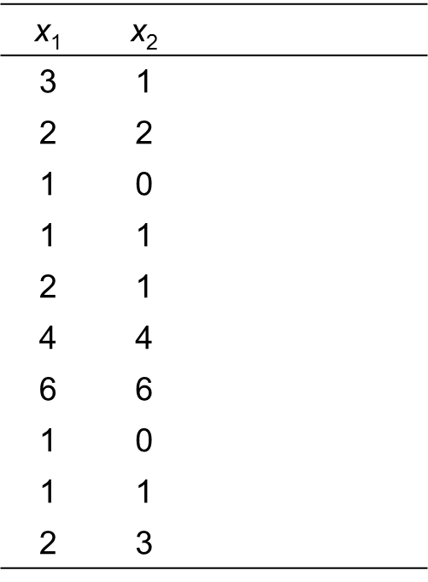
Do Formal Sanctions Deter?
Arrests among
offenders appearing
in court
Research question
Do formal sanctions
deter crime?

Slide 27
Do Formal Sanctions Deter? (cont.)

Slide 28
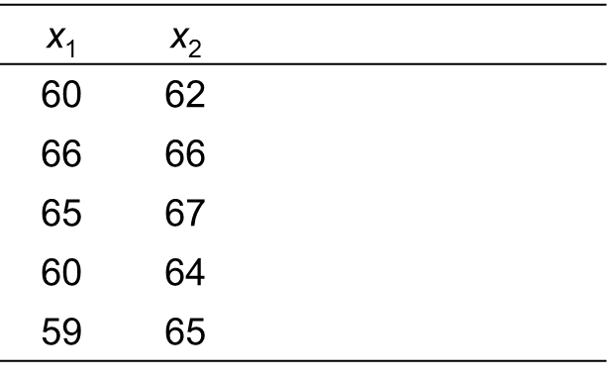
Test Scores
After-school tutoring
program to raise test
scores
Research question
Is the program effective in raising test scores?

Slide 29
Test Scores (cont.)

Slide 30
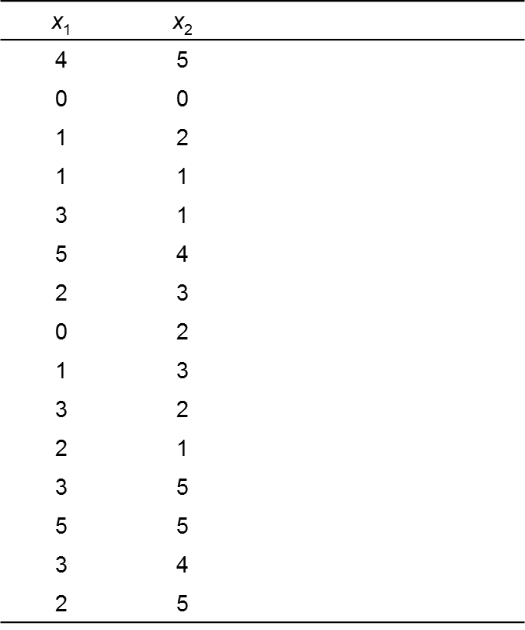
Youth Employment & Problem Behavior
Transition to work
Research Question
Is the transition to
youth employment
criminogenic?

Slide 31
Youth Employment & Problem Behavior (cont.)

